Slide 1

3
DIFFERENTIATION RULES

Slide 2
DIFFERENTIATION RULES
3.6
Derivatives of
Logarithmic Functions
In this section, we:
use implicit differentiation to find the derivatives of
the logarithmic functions and, in particular,
the natural logarithmic function.

Slide 3
DERIVATIVES OF LOGARITHMIC FUNCTIONS
An example of a logarithmic function
is: y = log_{a} x
An example of a natural logarithmic function is: y = ln x

Slide 4
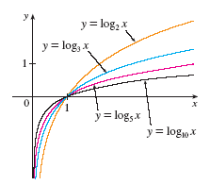
DERIVATIVES OF LOG FUNCTIONS
It can be proved that logarithmic functions are differentiable.
  This is certainly
  plausible from their
  graphs.

Slide 5
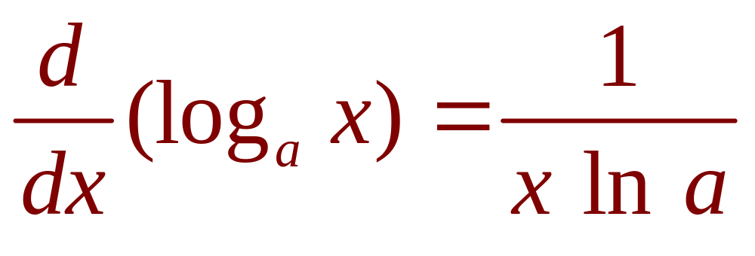
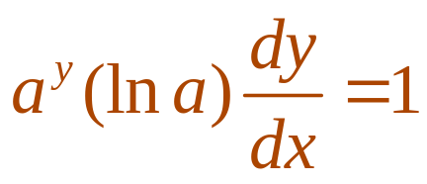
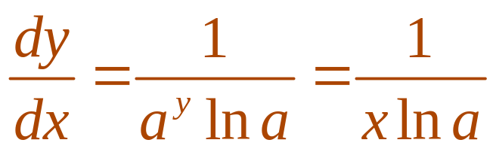
DERIVATIVES OF LOG FUNCTIONS
Formula 1—Proof
  Let y = log_{a} x.
  Then, a^{y} = x.
  Differentiating this equation implicitly with respect to x, using Formula 5 in Section 3.4, we get:
  So,

Slide 6
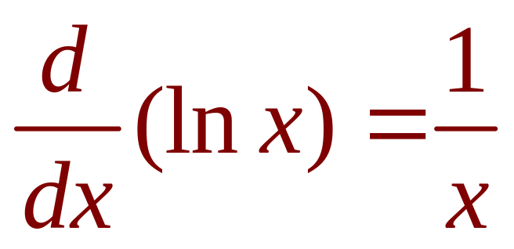
DERIVATIVES OF LOG FUNCTIONS
Formula 2
If we put a = e in Formula 1, then the factor
on the right side becomes ln e = 1 and we get the formula for the derivative of the natural logarithmic function log_{e} x = ln x.

Slide 7
DERIVATIVES OF LOG FUNCTIONS
By comparing Formulas 1 and 2, we see
one of the main reasons why natural logarithms (logarithms with base e) are used in calculus:
  The differentiation formula is simplest when
  a = e because ln e = 1.

Slide 8
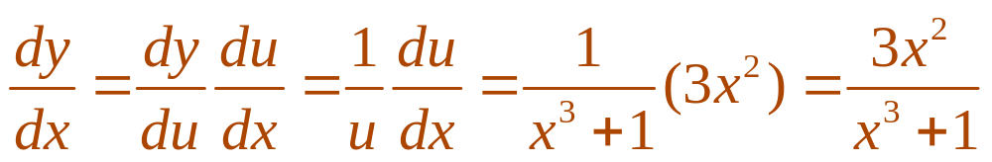
DERIVATIVES OF LOG FUNCTIONS
Example 1
Differentiate y = ln(x³ + 1).
  To use the Chain Rule, we let u = x³ + 1.
  Then y = ln u.
  So,

Slide 9
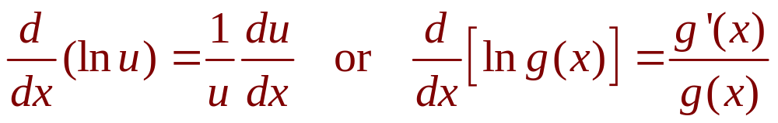
DERIVATIVES OF LOG FUNCTIONS
Formula 3
In general, if we combine Formula 2
with the Chain Rule, as in Example 1,
we get:

Slide 10
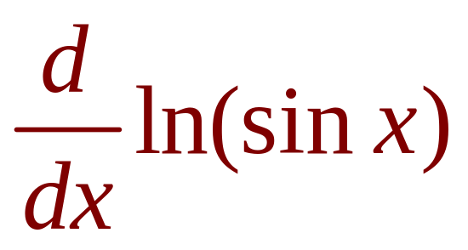
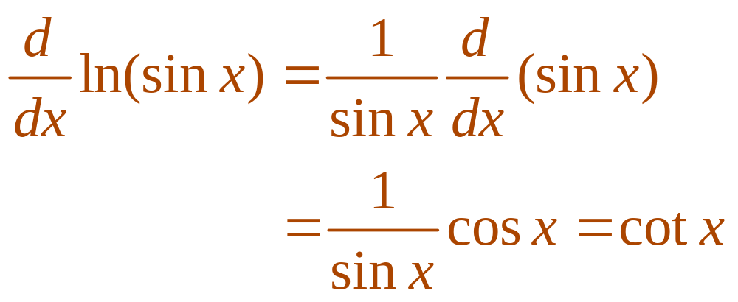
DERIVATIVES OF LOG FUNCTIONS
Example 2
Find .
  Using Formula 3, we have:

Slide 11
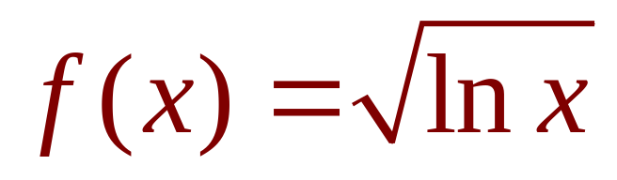
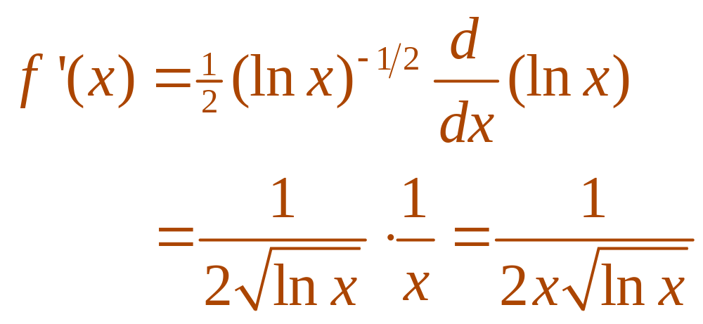
DERIVATIVES OF LOG FUNCTIONS
Example 3
Differentiate .
  This time, the logarithm is the inner function.
  So, the Chain Rule gives:

Slide 12
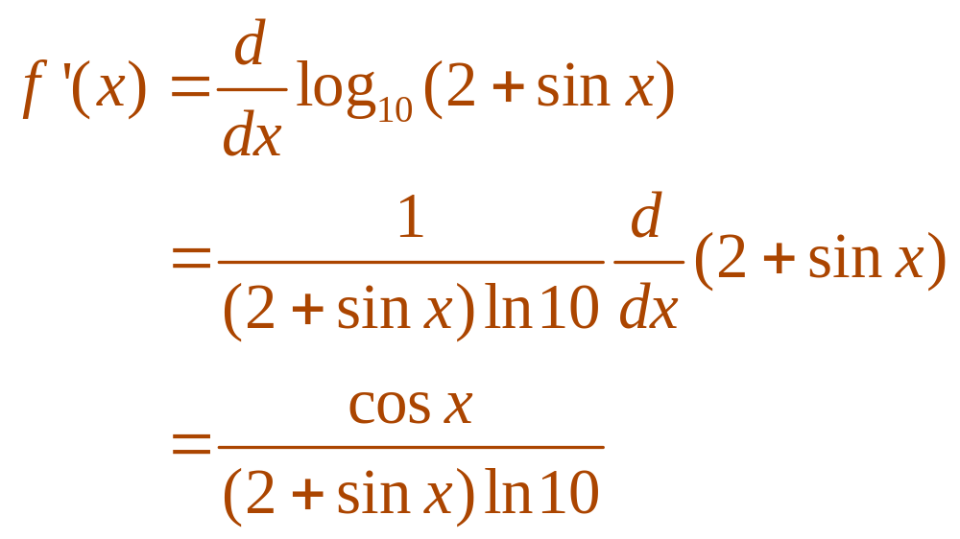
DERIVATIVES OF LOG FUNCTIONS
Example 4
Differentiate f(x) = log₁₀(2 + sin x).
  Using Formula 1 with a = 10, we have:

Slide 13
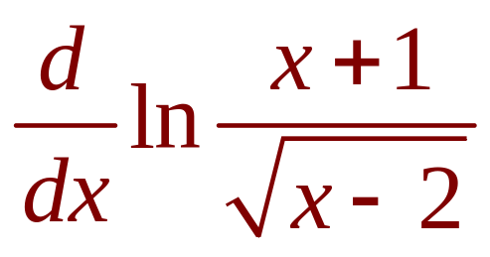
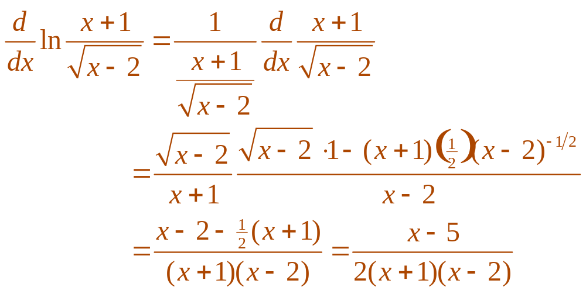
DERIVATIVES OF LOG FUNCTIONS
E. g. 5—Solution 1
Find .

Slide 14
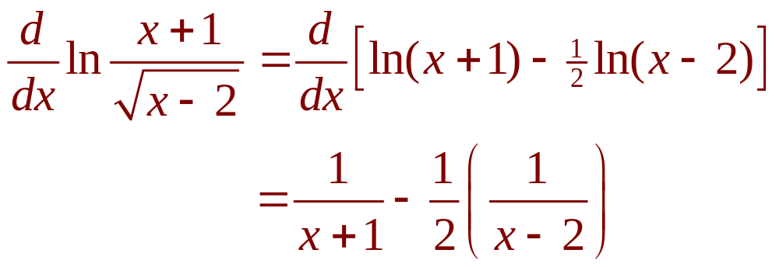
DERIVATIVES OF LOG FUNCTIONS
E. g. 5—Solution 2
If we first simplify the given function using
the laws of logarithms, then the differentiation becomes easier:
  This answer can be left as written.
  However, if we used a common denominator,
  it would give the same answer as in Solution 1.

Slide 15
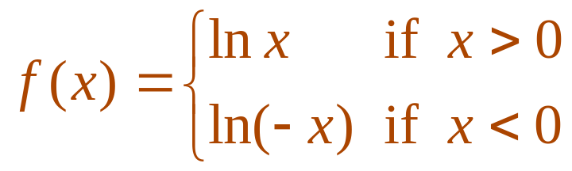
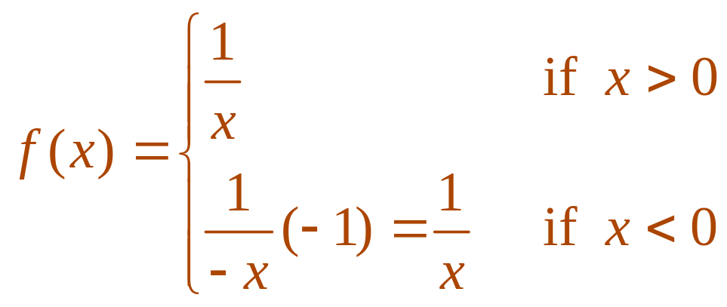
DERIVATIVES OF LOG FUNCTIONS
Example 6
Find f ’(x) if f(x) = ln |x|.
  Since
  it follows that
  Thus, f ’(x) = 1/x for all x ≠ 0.

Slide 16
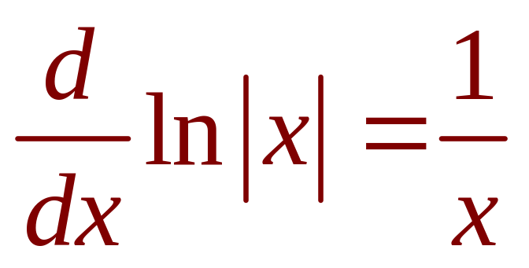
DERIVATIVES OF LOG FUNCTIONS
Equation 4
The result of Example 6 is
worth remembering:

Slide 17
LOGARITHMIC DIFFERENTIATION
The calculation of derivatives of complicated functions involving products, quotients, or powers can often be simplified by taking logarithms.
  The method used in the following example
  is called logarithmic differentiation.

Slide 18
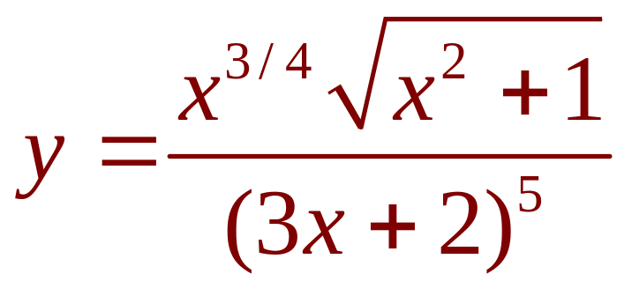
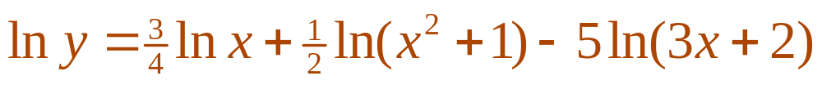
LOGARITHMIC DIFFERENTIATION
Example 7
Differentiate
  We take logarithms of both sides of the equation
  and use the Laws of Logarithms to simplify:

Slide 19
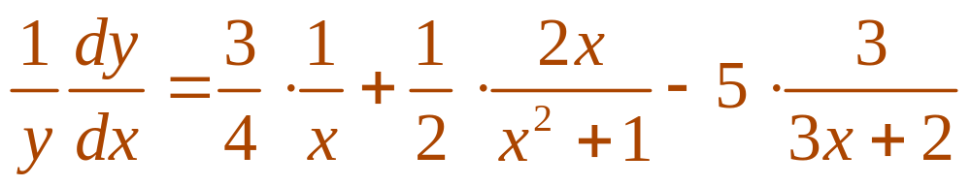
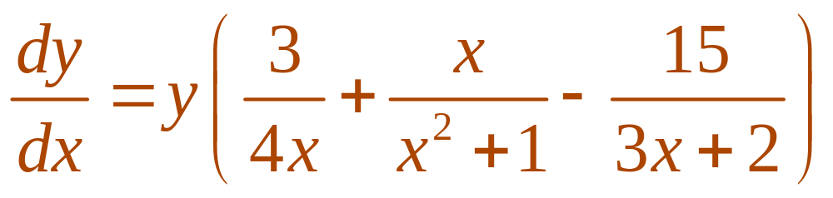
LOGARITHMIC DIFFERENTIATION
Example 7
  Differentiating implicitly with respect to x gives:
  Solving for dy / dx, we get:

Slide 20
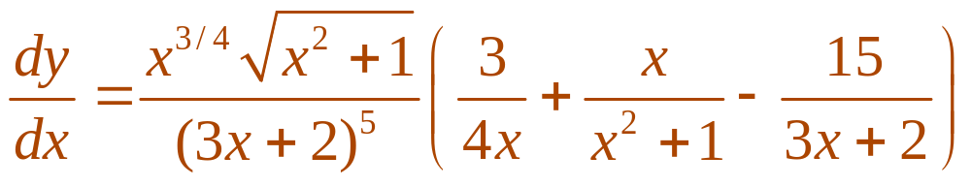
LOGARITHMIC DIFFERENTIATION
Example 7
  Since we have an explicit expression for y, we can substitute and write:

Slide 21
STEPS IN LOGARITHMIC DIFFERENTIATION
  Take natural logarithms of both sides of
  an equation y = f(x) and use the Laws of Logarithms to simplify.
  Differentiate implicitly with respect to x.
  Solve the resulting equation for y’.

Slide 22
LOGARITHMIC DIFFERENTIATION
If f(x) < 0 for some values of x, then ln f(x)
is not defined.
However, we can write |y| = |f(x)| and use Equation 4.
  We illustrate this procedure by proving the general version of the Power Rule—as promised in Section 3.1.

Slide 23
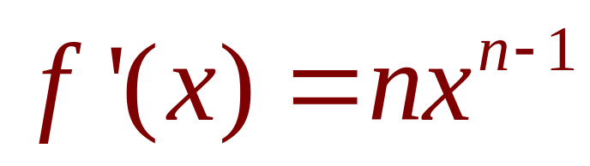
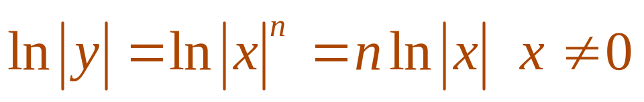
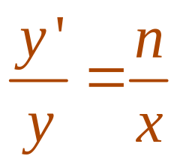
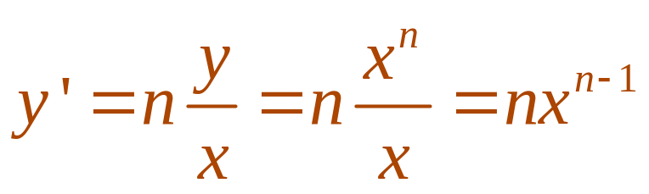
THE POWER RULE
PROOF
If n is any real number and f(x) = x^{n},
then
  Let y = x^{n} and use logarithmic differentiation:
  Thus,
  Hence,

Slide 24
LOGARITHMIC DIFFERENTIATION
You should distinguish carefully between:
  The Power Rule [(x^{n})’ = nx^{n-1}], where the base
  is variable and the exponent is constant
  The rule for differentiating exponential functions
  [(a^{x})’ =a^{x} ln a], where the base is constant and
  the exponent is variable

Slide 25
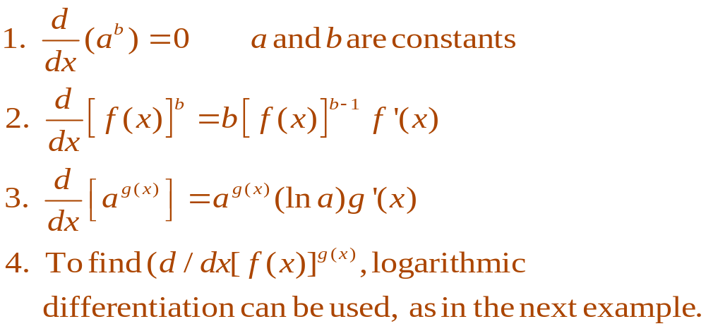
LOGARITHMIC DIFFERENTIATION
In general, there are four cases for exponents and bases:

Slide 26
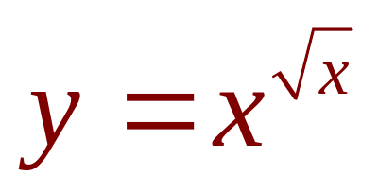
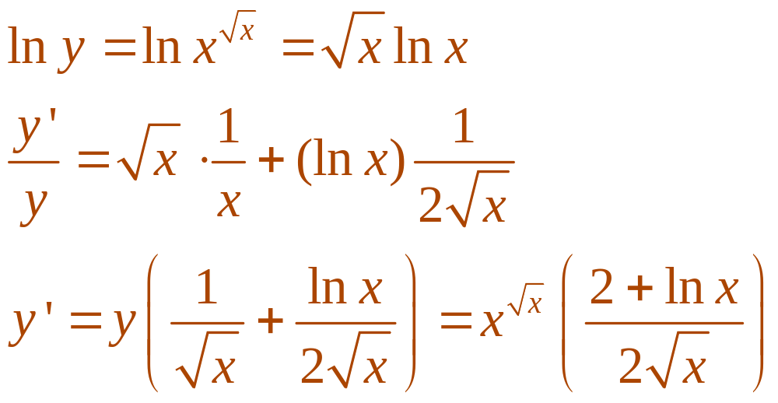
LOGARITHMIC DIFFERENTIATION
E. g. 8—Solution 1
Differentiate .
  Using logarithmic differentiation,
  we have:

Slide 27
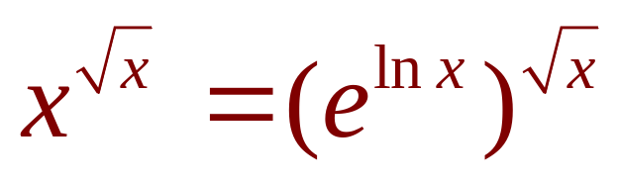
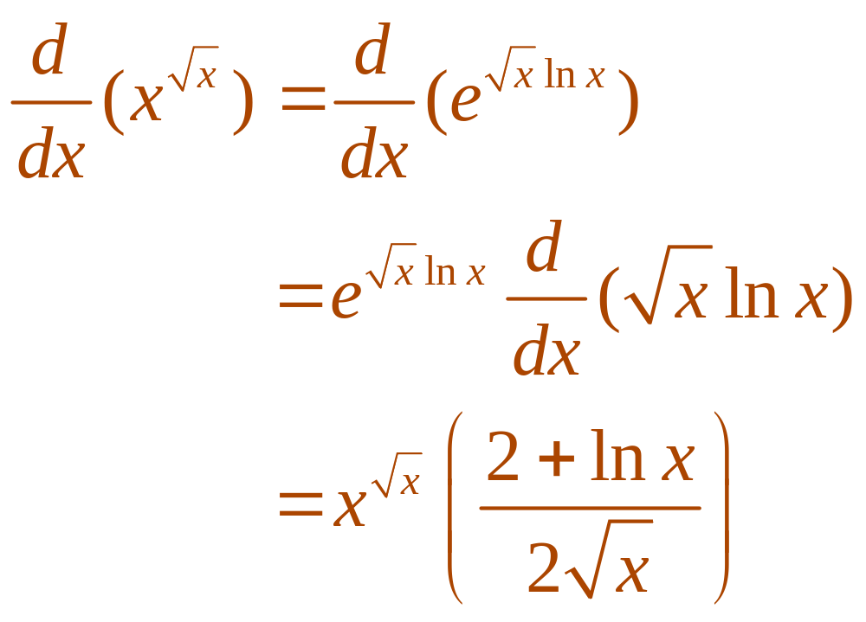
LOGARITHMIC DIFFERENTIATION
E. g. 8—Solution 2
Another method is to write .

Slide 28
THE NUMBER e AS A LIMIT
We have shown that, if f(x) = ln x,
then f ’(x) = 1/x.
Thus, f ’(1) = 1.
  Now, we use this fact to express the number e
  as a limit.

Slide 29
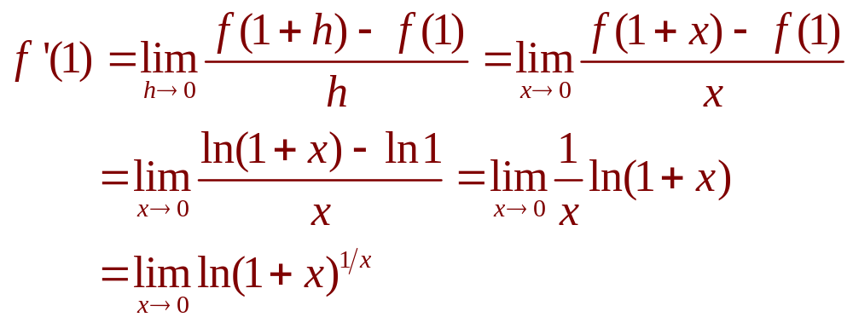
THE NUMBER e AS A LIMIT
From the definition of a derivative as
a limit, we have:

Slide 30
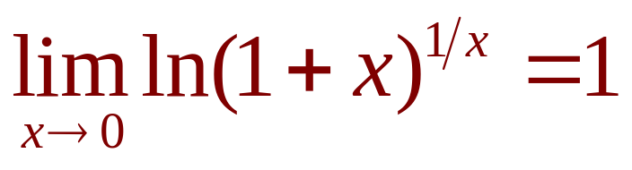
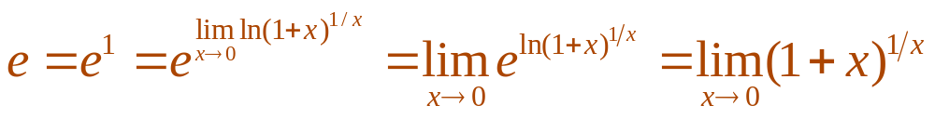
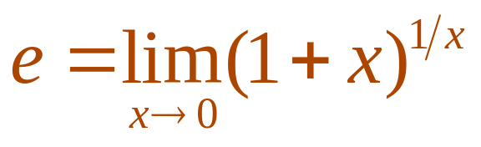
THE NUMBER e AS A LIMIT
Formula 5
As f ’(1) = 1, we have
  Then, by Theorem 8 in Section 2.5 and
  the continuity of the exponential function,
  we have:

Slide 31
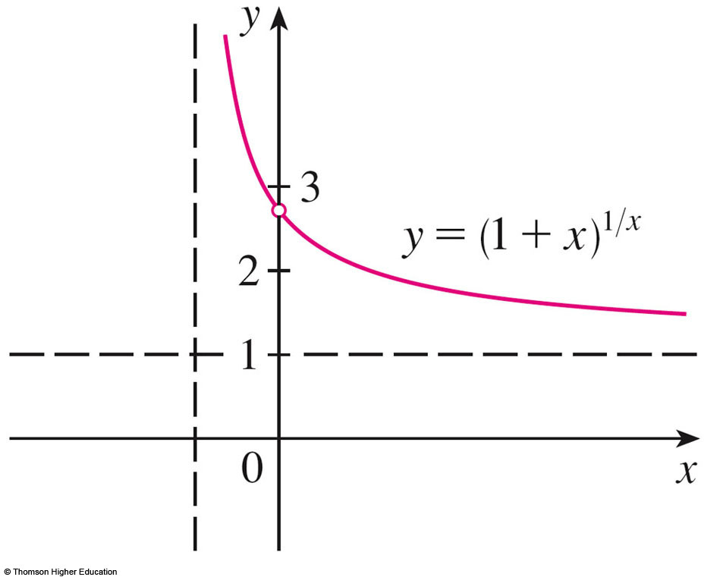
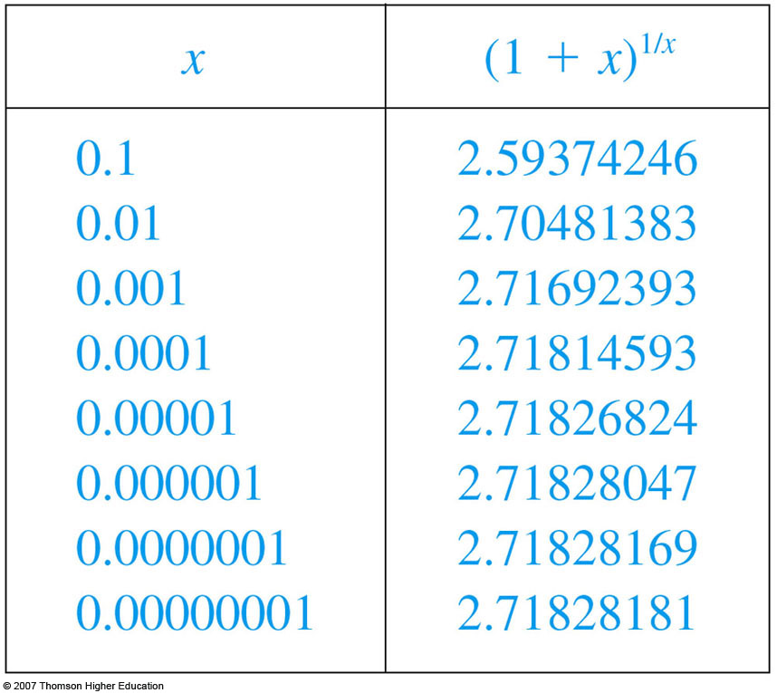
THE NUMBER e AS A LIMIT
Formula 5 is illustrated by the graph of
the function y = (1 + x)^{1/x} here and a table
of values for small values of x.

Slide 32
THE NUMBER e AS A LIMIT
This illustrates the fact that, correct to seven decimal places, e ≈ 2.7182818

Slide 33
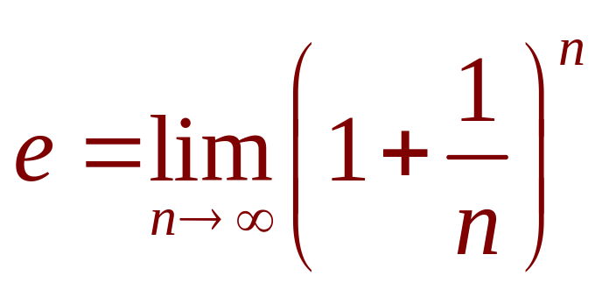
THE NUMBER e AS A LIMIT
Formula 6
If we put n = 1/x in Formula 5, then n → ∞
as x → 0⁺.
So, an alternative expression for e is:

